Slide 1
Programming Fundamentals
Lecture – 2
Instructor: Khurram Iqbal
Email: Khurram.Iqbal@comsats.edu.pk

Slide 2
Computer Programming Languages
Lecture – 1
Instructor: Khurram Iqbal
Email: Khurram.Iqbal@comsats.edu.pk

Slide 3
Computer Basics
Computer systems consist of hardware and software
A set of instructions for the computer to carry out is called a program
All the different kinds of programs used to give instructions to the computer are collectively referred to as software

Slide 4
Hardware and Memory
The CPU, or central processing unit, or processor, performs the instructions in a program
Computer’s memory holds data for the computer to process
It holds the result of the computer’s intermediate calculations
A byte is the quantity of memory
1 gigabyte of RAM is approximately 1 billion bytes of memory

Slide 5
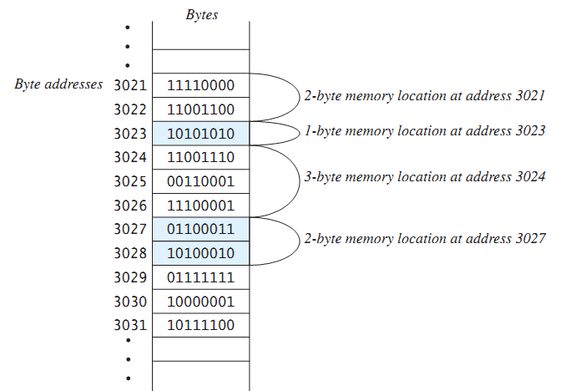
Hardware and Memory
Main memory consists of a long list of numbered bytes
The number of a byte is called its address
A byte is the smallest addressable
unit of memory
Data (numbers, letters and string of characters) is encoded as a series of 0s and 1s and placed in the computer’s memory

Slide 6
Programming Languages
Computer programs(software) are instructions that tell a computer what to do
Many programming languages
All programs are converted into instructions that computer can execute
Types of Languages
Machine Language
Assembly Language
High-Level Language
Example
To add Two Numbers:
1101101010011010
add 2, 3, result
result = 2 + 3

Slide 7
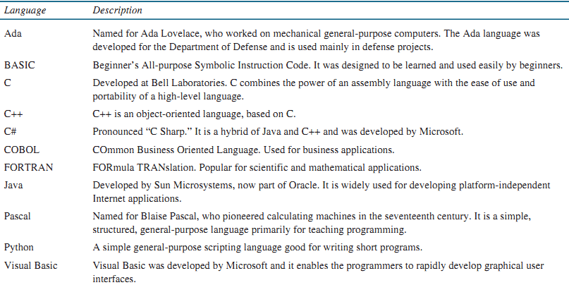

Slide 8
Programming Paradigm
A paradigm is a system of concepts and practices that reflect the current state of our understanding of the field
A programming paradigm refers to a style, way, or classification of programming
Imperative in which the programmer instructs the machine how to change its state.
Examples: C, C++, Java, PHP, Python, Ruby etc.
Declarative the programmer states only what the result should look like, not how to obtain it
Notes:
HOW means describing the Inputs and describing how the Outputs are produced.

Slide 9
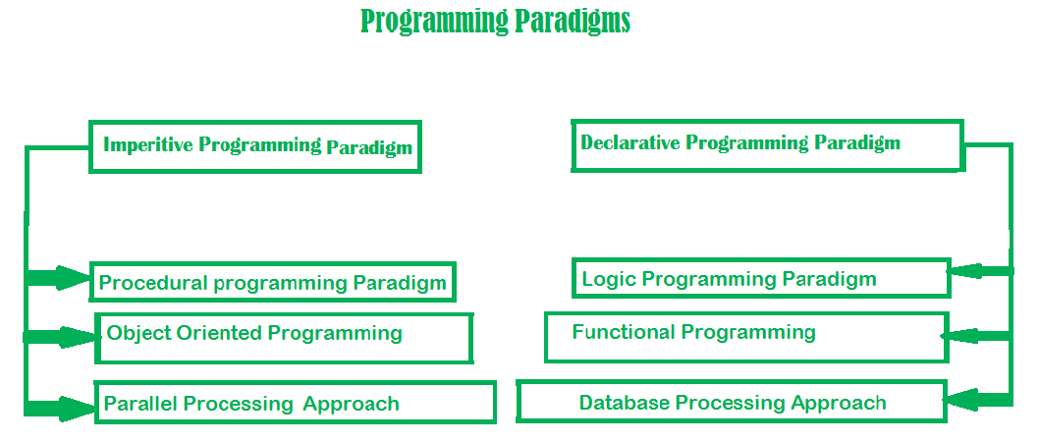

Slide 10
Programming Paradigms
Imperative programming
Imperative means: giving a command/instruction
A computer program describes a sequence of steps that change the state of the computer. E.g. C, C++ etc.
You need to tell every step to perform a task.
void main(){
int d;
int a, b;
a = 1; b = 1;
d = a/b;
cout<<“division”<<d;
}

Slide 11
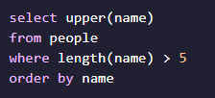
Programming Paradigms
Declarative programming
Another programming paradigm where you describe the results that you want, but not how to get there. E.g SQL, Prolog etc.

Slide 12
Programming Paradigm
Programming languages are used in order to solve problems
Structured/Procedural Programming
Functional Programming
Object-oriented Programming

Slide 13
Structured Programming
Kind of imperative programming
Control flow is defined by nested loops, conditionals, and subroutines
Sequence, Selection and Repetition
x= 5; y = 11; z = x + y; System.out.println(z);
if (x % 2 == 0) { System.out.println("The number is even."); }
while(x < 100) { System.out.println(x); x = x * x }

Slide 14
Procedural Programming
A language derived from structure programming and based on the use of call procedures
Procedures are the functions, routines, or subroutines that specify the computational steps that need to be performed
A program is designed using a top-down approach in procedural programming
C/C++ starts execution from main() top function
Examples: COBOL, BASIC, PASCAL, FORTRAN, and C

Slide 15
Example (C Language)
#include <stdio.h>
// Function to add two numbers
int add(int a, int b) {
return a + b;
}
int main() {
int num1, num2;
printf("Enter two numbers: ");
scanf("%d %d", &num1, &num2);
int sum = add(num1, num2);
printf("Sum: %d\n", sum);
return 0;
}

Slide 16
Object Oriented Programming (OOP)
Object-oriented programming is about creating objects that contain both data and methods
Classes and objects are the two main aspects of object-oriented programming
Examples: C++, C#, Java, Python.
Class | Object
Fruit | Apple, Banana, Mango
Car | Volvo, Audi, Toyota
Student | Ali, Hamza, Ahmad

Slide 17
Programming Paradigm
Example
public class Car {
String carReg;
int carModel;
String carClass;
public Car(String num) {
carReg = num;
}
public String getReg(){
return carReg;
}
public static void main(String[] args) {
Car Audi = new Car("AX-7865");
System.out.println(Audi.getReg());
}
}

Slide 18
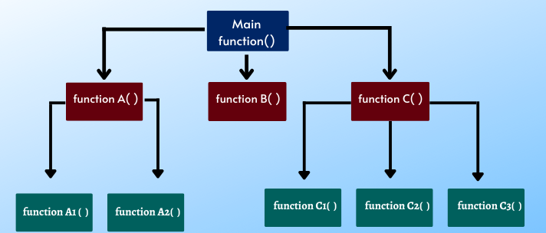
Functional Programming (FP)
Program is composed of series of short functions.
All code is within the functions
All variables are scoped to function
Examples: C++, Python, Java Script, Lisp, Haskell

Slide 19
Functional Programming (FP)
Here are some aspects of FP:
First-class functions
Higher-order function
Pure functions and side-effects

Slide 20
First-class functions
It means that a function is just another value that we can:
Pass to other functions
Save in a variable
Return from other functions
function addTwoNums(a, b) {
console.log(a + b)
}
function randomNum() {
return Math.floor((Math.random() * 10) + 1);
}
function specificNum() { return 42 };
var useRandom = true;
var getNumber;
if(useRandom) {
getNumber = randomNum
} else {
getNumber = specificNum
}
addTwoNums(getNumber(), getNumber())
Functions can be assigned to variable names and passed around just like you would pass around a string, a number, an object, etc.
function sayHello() {
return () => {
console.log("Hello!");
};
}

Slide 21
Higher-order functions
A higher-order function is a function that has either one or both of the following characteristics:
It accepts other functions as arguments
It returns functions when invoked
function addTwoNums(getNumber1, getNumber2) {
console.log(getNumber1() + getNumber2());
}
addTwoNums(specificNum, specificNum); // returned number is 84
addTwoNums(specificNum, randomNum); // returned number is 42 + some random number

Slide 22
Pure functions and side-effects
A pure function returns the exact same result as long as it's given the same values.
It should not have side-effects.
A side-effect is any instance where a function makes a change outside of itself.
E.g. changing variable values outside of the function itself
function addTwoNums(a, b) {
return a + b
}
addTwoNums(5,6); // 11
//Impure Function
function addTwoNums(a, b) {
const rnd = Math.random();
return a + b + rnd;
}

Slide 23
FP-Example
Example
Summing the integers 1 to 10 in Java:
The computation method is variable assignment
Example
Summing the integers 1 to 10 in Haskell (Functional Language) :
The computation method is function application
sum [1..10]
int total = 0;
for (int i = 1; i ≤ 10; i++)
total = total + i;

Slide 24
FP-Example
import java.util.Arrays;
import java.util.List;
public class Functional{
public static void main(String[] args){
List<Integer> numbers = Arrays.asList(11, 22, 33, 44, 55, 66, 77, 88, 99, 100);
final int factor = 2;
//Declarative
numbers.stream()
.filter(number->number%2==0)
.forEach(System.out::println);
//imperative
for(int number: numbers){
if(number%2 ==0)
System.out.println(number);
}
}
}

Slide 25
Program Development

Slide 26
Outline
Program Development Cycle
Algorithm
The First Four Steps

Slide 27
Programming: Plan First, Then Code
A good programmer will plan first and write second
Breaking down a large programming task into several smaller tasks

Slide 28
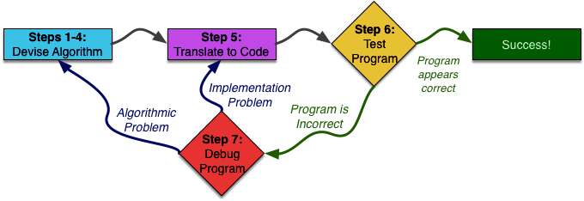
An Overview of Seven Steps

Slide 29
Algorithm
Set of well-defined logical steps that must be taken to perform a task
For example, suppose you have been asked to write a program to calculate and display the gross pay for an hourly paid employee.
Here are the steps that you would take:
1. Get the number of hours worked.
2. Get the hourly pay rate.
3. Multiply the number of hours worked by the hourly pay rate.
4. Display the result of the calculation that was performed in Step 3.

Slide 30
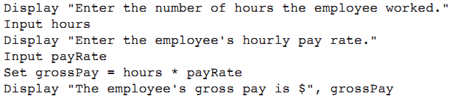
Pseudocode
Pseudocode: fake code
Informal language that has no syntax rule
Not meant to be compiled or executed
Used to create model program
No need to worry about syntax errors, can focus on program’s design
Can be translated directly into actual code in any programming language

Slide 31
Flowcharts
Flowchart: diagram that graphically depicts the steps in a program
Ovals are terminal symbols
Parallelograms are input and output symbols
Rectangles are processing symbols
Symbols are connected by arrows that represent the flow of the program

Slide 32
Flow Chart – Raptor Example

Slide 33
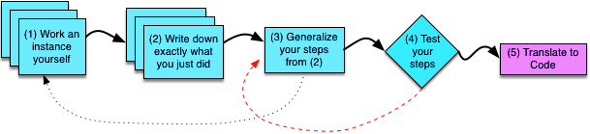
First Four Steps
Step 1: Work an Example Yourself
Step 2: Write Down What You Just Did
Step 3: Generalize Your Steps
Step 4: Test Your Algorithm

Slide 34
Example-1
Write a program to compute x raised to the y power (x ^{y})
Step 1: Work an Example Yourself
x = 3 and y = 4, getting an answer of 3^4 = 81.

Slide 35
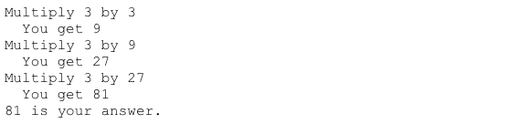
Example-1
Step 2: Write Down What You Just Did

Slide 36
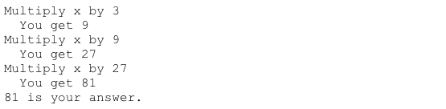
Example-1
Step 3: Generalize Your Steps
1-Replacing this occurrence of 3 with x

Slide 37
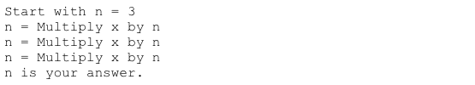

Example-1
Step 3: Generalize Your Steps
2-Find repetition

Slide 38

Example-1
Step 3: Generalize Your Steps

Slide 39
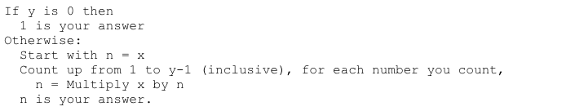
Example-1
Step 4: Test Your Algorithm

Slide 40

Example-1
Step 4: Test Your Algorithm

Slide 41
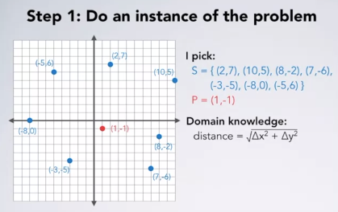
Example-2
Problem: Find the closest point out of a set of points to some other given point

Slide 42
Example-2

Slide 43
Example-2
8.06
Smallest Distance: 8.06

Slide 44
Example-2
8.06
10.82
Smallest Distance: 8.06

Slide 45
Example-2
8.06
7.07
Smallest Distance: 7.07

Slide 46
Example-2
7.07
7.81
Smallest Distance: 7.07

Slide 47
Example-2
7.07
5.66
Smallest Distance: 5.66

Slide 48
Example-2
9.06
5.66
Smallest Distance: 5.66

Slide 49
Example-2
9.22
5.66
Smallest Distance: 5.66

Slide 50
Example-2
5.66
Smallest Distance: 5.66

Slide 51
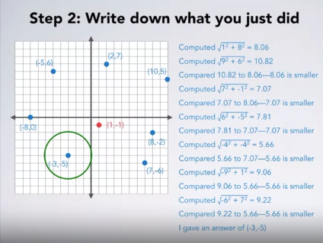
Example-2

Slide 52
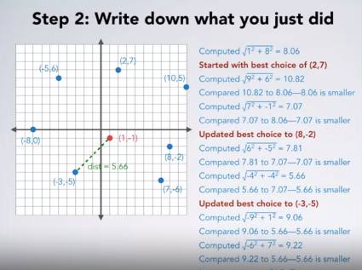
Example-2
5.66

Slide 53
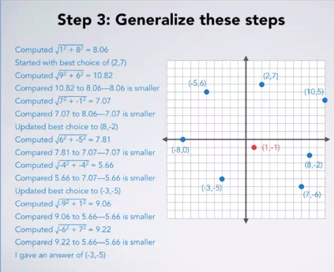
Example-2

Slide 54
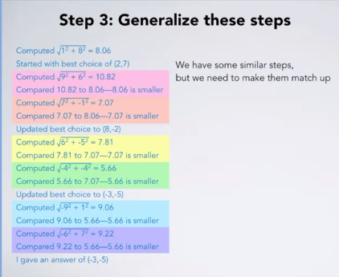
Example-2

Slide 55
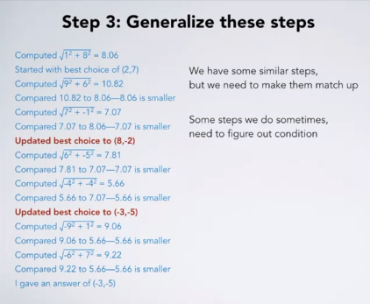
Example-2

Slide 56
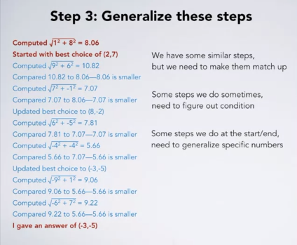
Example-2

Slide 57
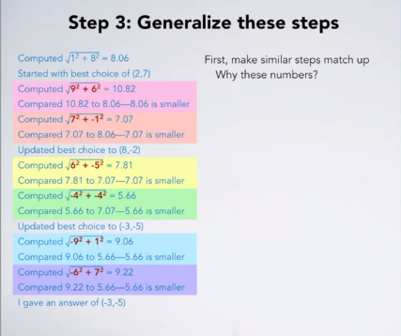
Example-2

Slide 58
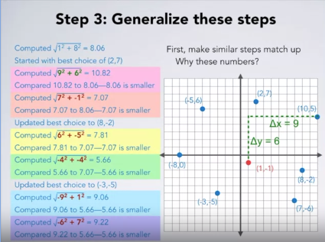
Example-2

Slide 59
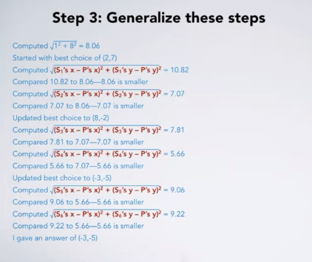
Example-2

Slide 60
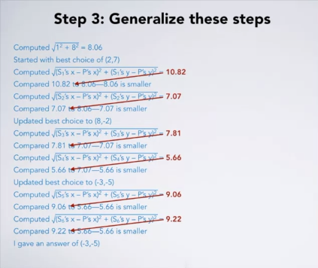
Example-2

Slide 61
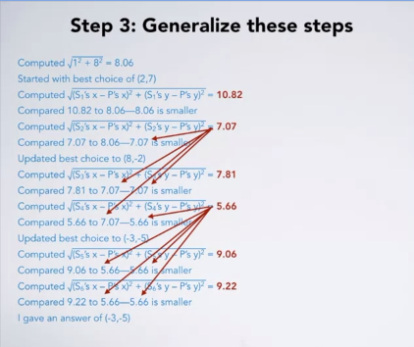
Example-2

Slide 62
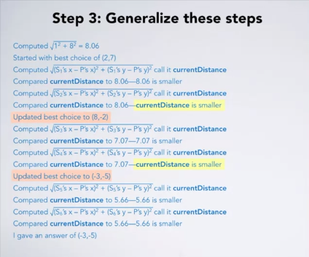
Example-2

Slide 63
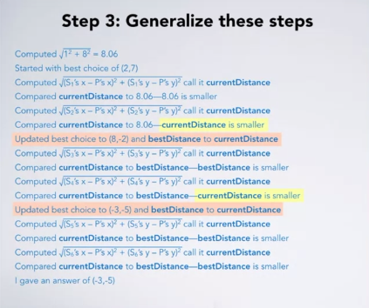
Example-2
Call it bestDistance

Slide 64
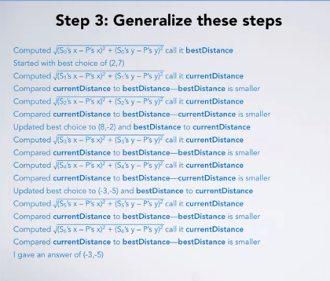
Example-2
Replace it with S0
Replace it with S1
Replace it with S2

Slide 65
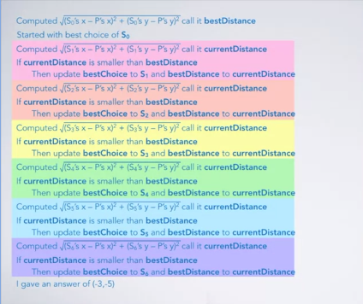
Example-2

Slide 66
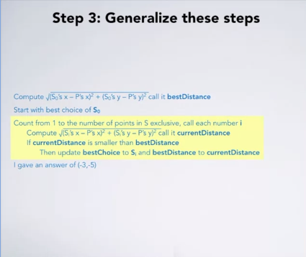
Example-2

